Slide 1
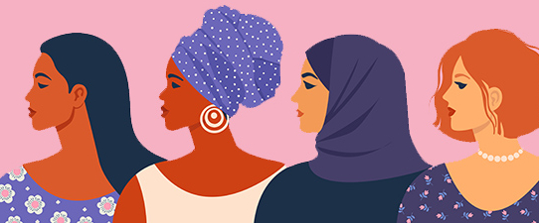
International Women's Day

Slide 2
Activity #1
On a sheet of paper, draw a person for each of the following occupations:
Doctor
Nurse
Police Officer
Hairdresser
Discuss drawings as a class
What does your [doctor/nurse] look like?
What would you name them?
Record how students imagined people in these occupations

Slide 3
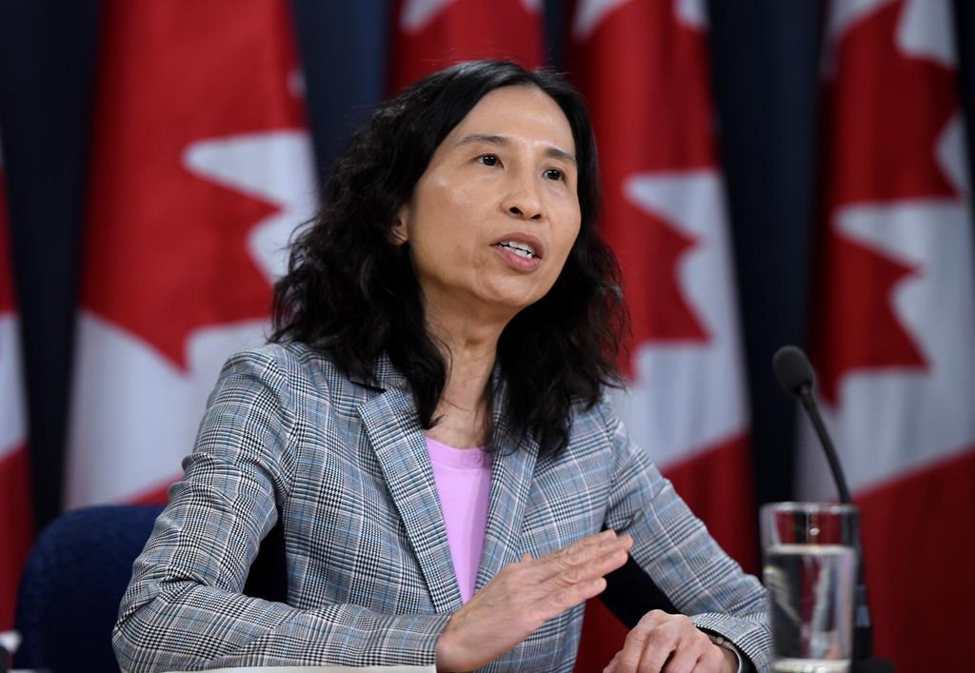
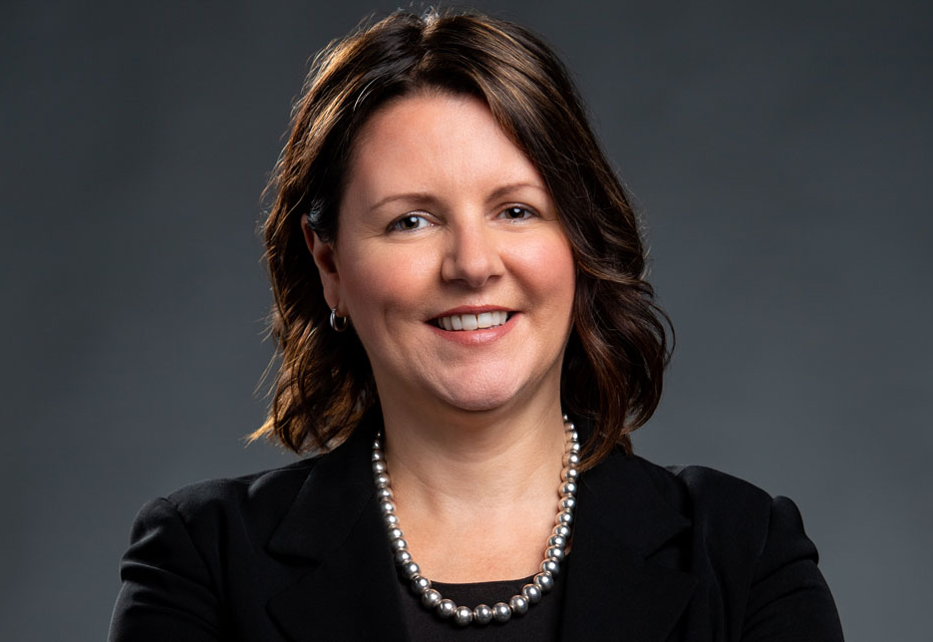
Dr. Theresa Tam
Chief Public Health Officer
of Canada
Dr. Jennifer Russell
Chief Medical Officer
of Health for New Brunswick

Slide 4
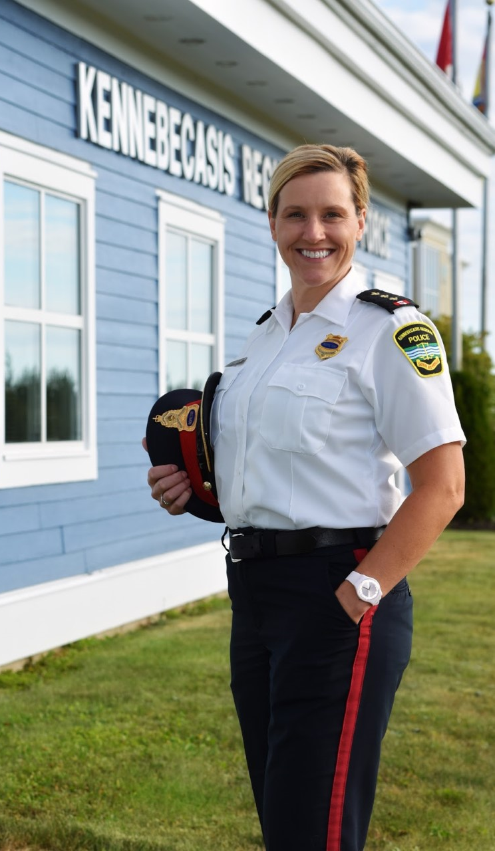
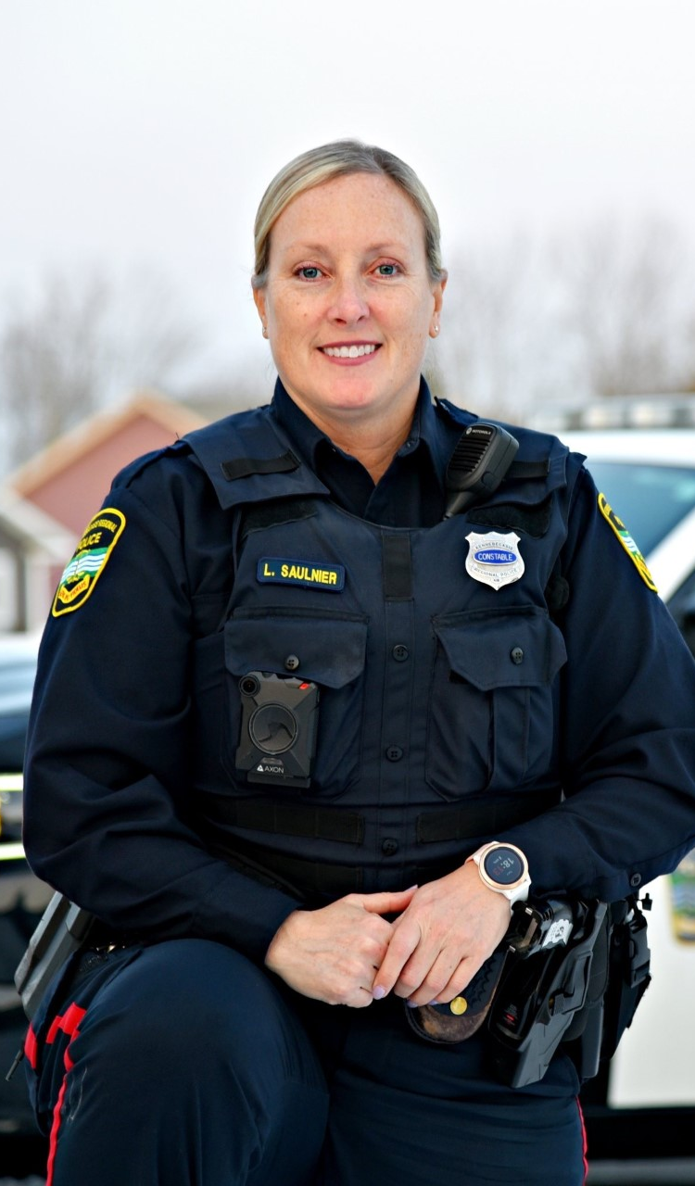
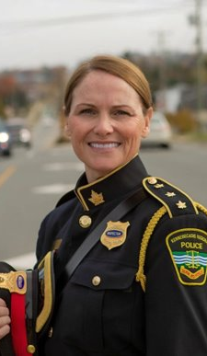
Insp. Anika Becker
Cst. Lynn Saulnier
Insp. Mary Henderson

Slide 5
What is International Women's Day?
A day to recognize the achievements of women around the world.
A day to bring awareness to issues of gender equality.
A day to empower women and girls around the world.

Slide 6
What is Gender Equality?

Slide 7
Did you know...
Women, on average, earn 25-40% less than men who do the same job.
Across the world, over 60% of the people who cannot read are women.
81% of women polled in a Canadian survey felt it is expected that women do the cooking, cleaning and caregiving at home.
Are these facts surprising to you? How do you feel about them?

Slide 8
Discussion
Do you think International Women's Day is important? Why?
What are some of the ways that girls and boys are treated differently?
What can we do to help achieve gender equality?

Slide 9
Read Aloud

