Slide 1
UNESCO Goal #13

Slide 3
What is a climate?
https://www.youtube.com/watch?v=Sv7OHfpIRfU
Climate versus weather
Climate is over time
Weather is day-to-day

Slide 4
What ARE SOME OF THE THINGS THAT ARE MAKING OUR PLANET SICK?
What did you see in the video?

Slide 5
What does this mean for New Brunswick?
How is climate change impacting our Province?

Slide 6
Has climate change impacted New Brunswick?
YES! Climate change has impacted NB.
What are two of the biggest contributors to GHG emissions? (Green House Gas).
Transportation and Electricity
How has Climate Change Impacted our province?
Floods, post-tropical storms (Dorian), ice storms. These environmental events cause property destruction, power outages and damage to buildings.
In a nutshell, New Brunswickers can expect to see increased temperatures, stormier weather and wetter weather.
What are some things you can do to decrease your carbon footprint?

Slide 7
What can YOU do?
Brainstorm a list of ideas of what you can do to help the Earth.

Slide 8
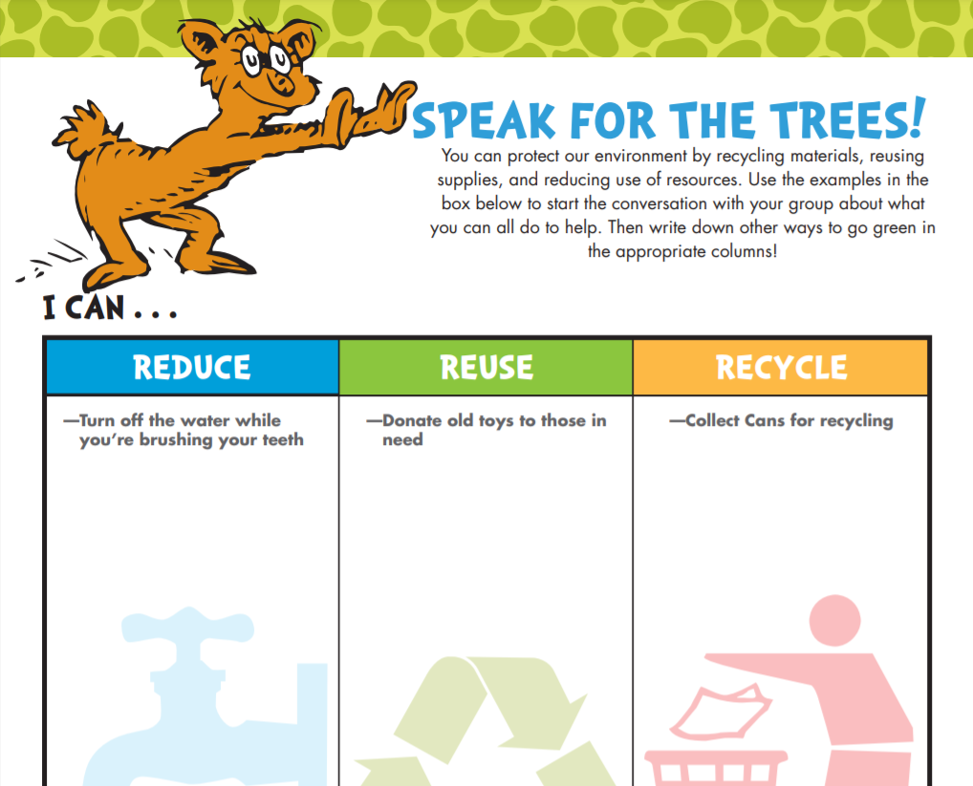
I CAN REDUCE, REUSE AND RECYCLE

Slide 9
I CAN SAVE ELECTRICITY
Talk about what you can do at school or at home to save electricity.
This afternoon, from 12:30-1:00 p.m., we will be doing Lights Out Lakefield!
Why would we do this?

Slide 10
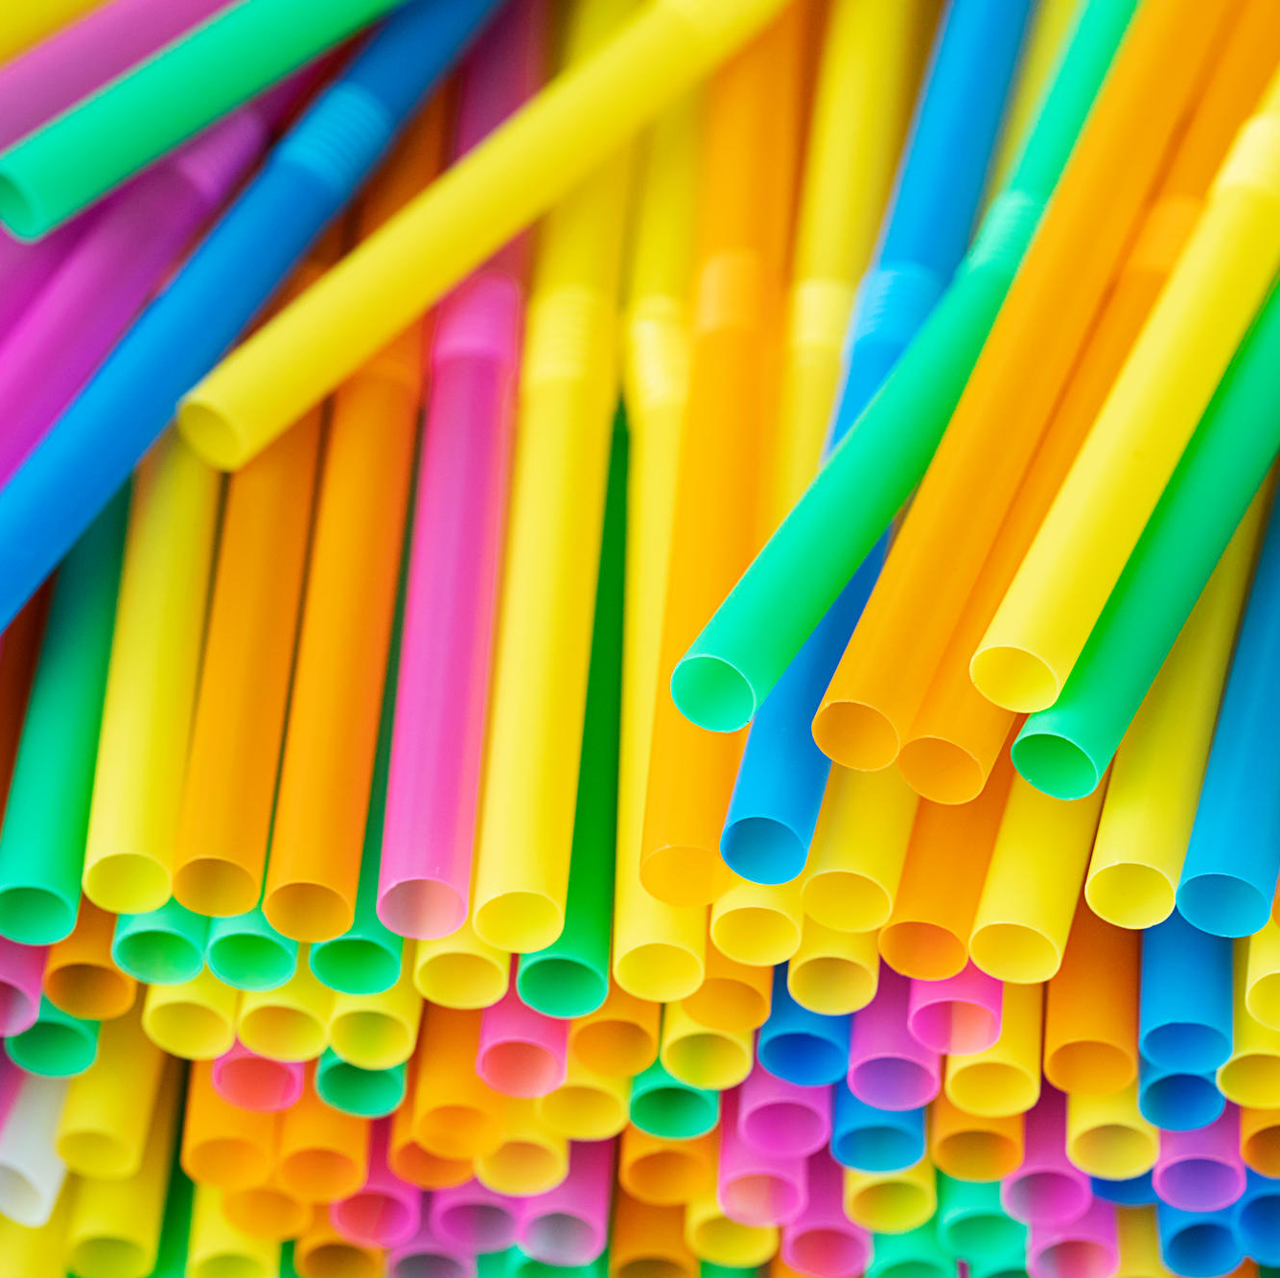
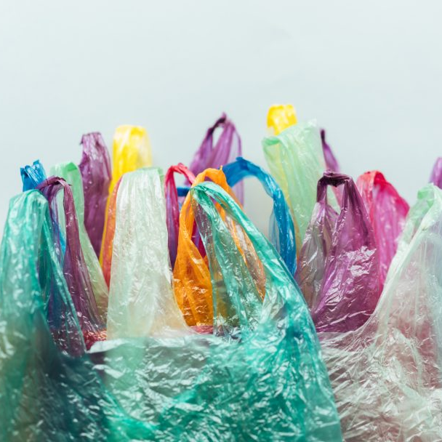
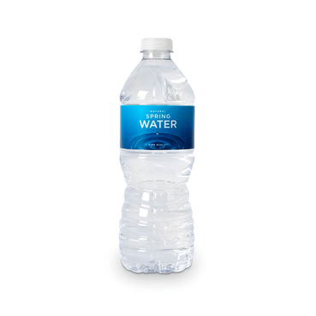
I CAN USE LESS SINGLE USE PLASTICS
What can I use instead of these single use plastics?

Slide 11
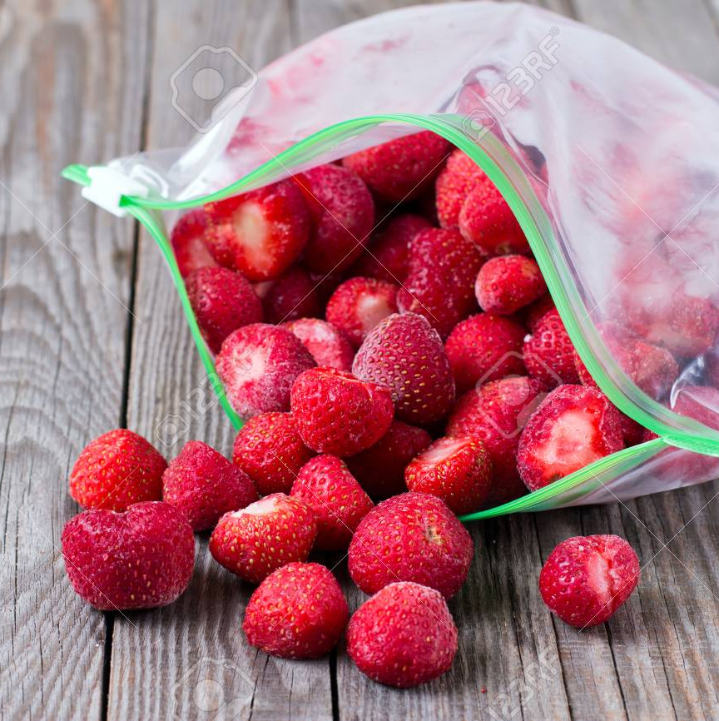
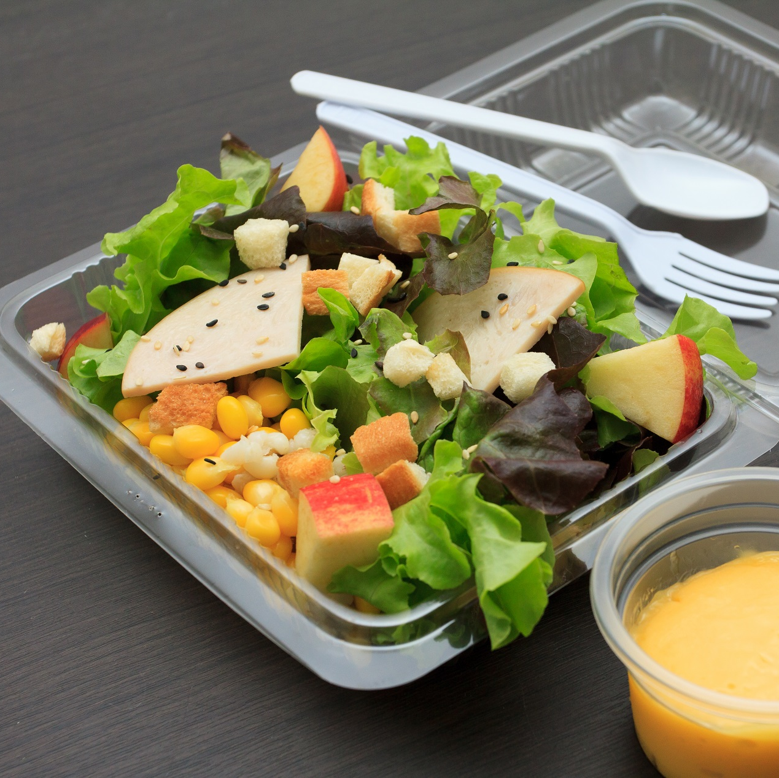
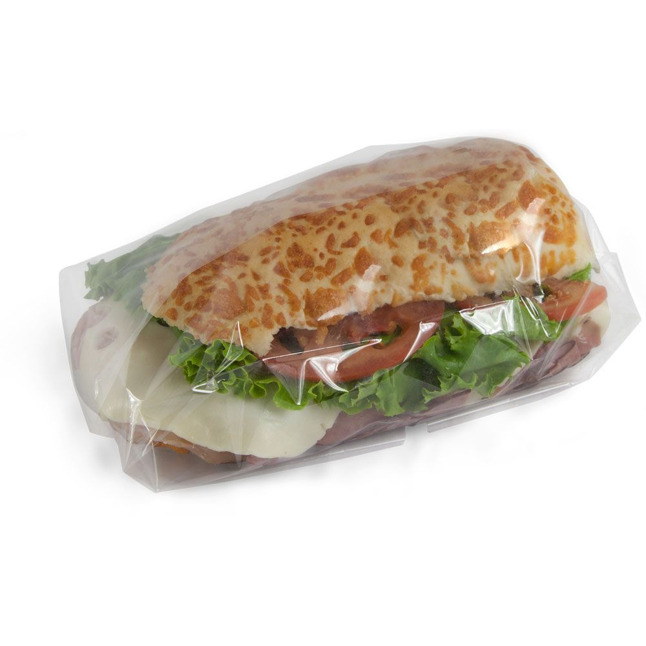
I CAN MAKE BETTER LUNCH BOX CHOICES
What can I pack instead of these?

Slide 12
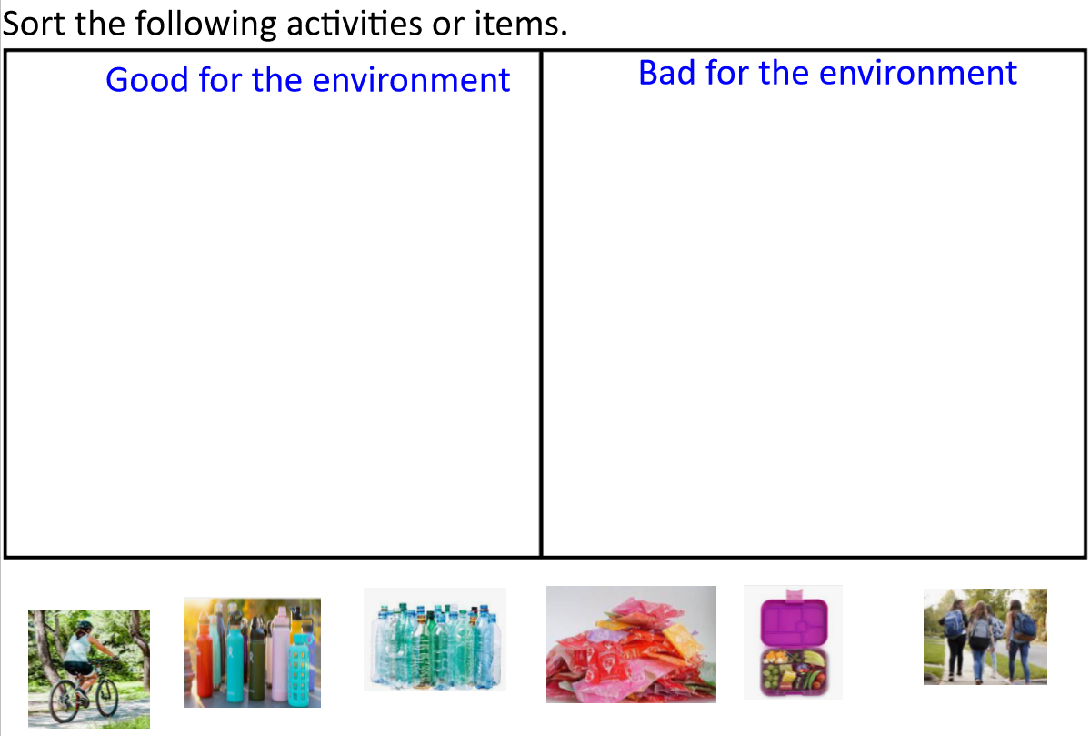
Please complete sorting activity now ☺ (SMART Notebook)

Slide 13
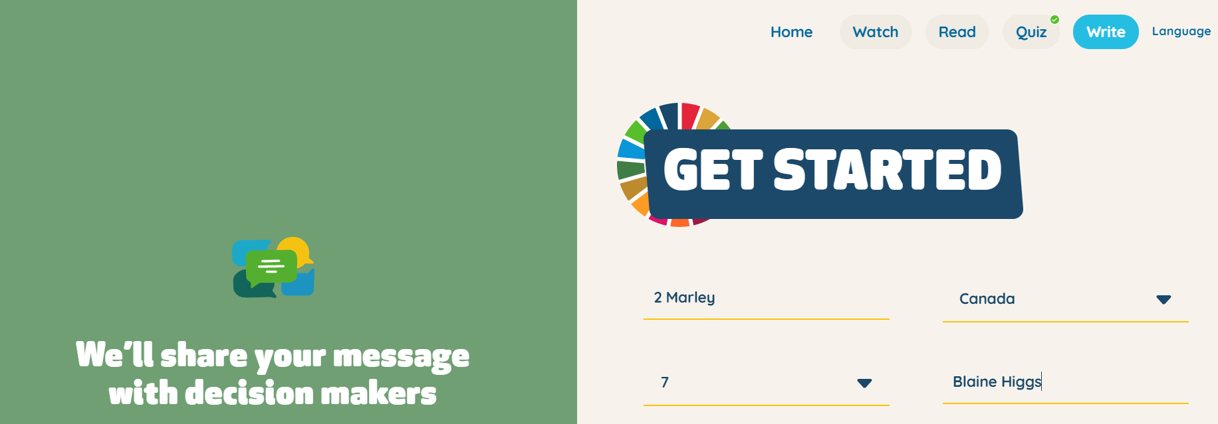
I CAN SPEAK UP… I CAN MAKE A DIFFERENCE
Follow this link
and write to:
Blaine Higgs
Justin Trudeau
https://climatechangemakers.worldslargestlesson.globalgoals.org/write/create

Slide 14
Writing activity
With the green strips of paper, please have each student write something that they can do to help the Earth.
They will bring this home and share with their families ☺

Slide 15
The lorax – read aloud
https://www.youtube.com/watch?v=GkO29Z1hvhY

Slide 16
Extra resources
UNESCO Climate Change Quiz
https://climatechangemakers.worldslargestlesson.globalgoals.org/quiz
The Bay vs The Bag
https://www.youtube.com/watch?v=jSD21zp89zM

