Slide 1
Good Health and Well-being
UNESCO Goal #3

Slide 2
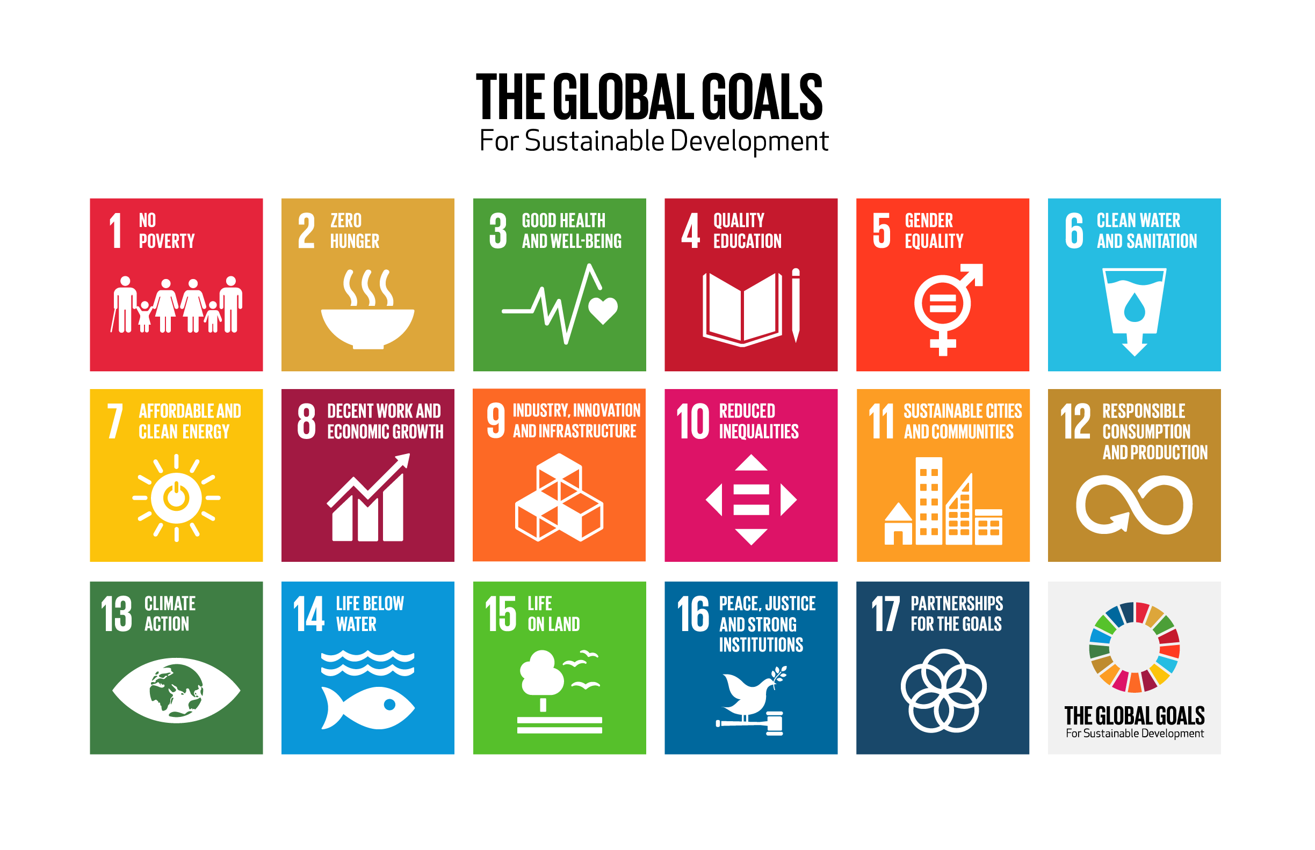
UNESCO

Slide 3
Brainstorm.
What are some ways we stay healthy and safe?

Slide 4
Goal #3: Good Health and Well-Being
Watch the video below.
Think about what good health and well-being means.
What makes a healthy country?
https://www.youtube.com/watch?v=9qiVBF_7wvY

Slide 5
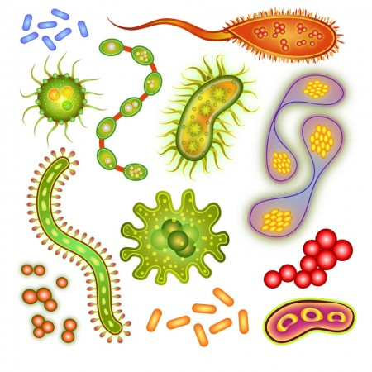
In the video…
What is the difference between a communicable and non-communicable disease?
Communicable diseases are infectious. That means they can be passed along from one person to another. Non-communicable diseases cannot be passed along.
“Illnesses know no borders.” What did the speaker mean by this statement?
Communicable diseases don’t just stop at a country’s border. They can travel between countries and across the globe. But so can medicine to help cure these diseases! We can all work together to eliminate many illnesses through the world.
Is COVID-19 a communicable or non- communicable disease? How does it affect many countries and many different groups of people?
Can you think of any challenges that make it hard for a country or place to control a germ like covid-19?

Slide 6
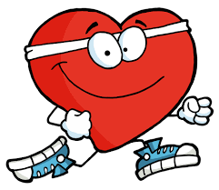
Domains of Personal Wellness
Today, we will focus on two domains of Personal Wellness: Physical Wellness and Emotional Wellness.
Physical Wellness: Exercising, moving our body, eating healthy, washing our hands, getting a good night’s sleep,etc.
Emotional Wellness: positive thoughts, feelings and emotions, making connections with others, etc.

Slide 7
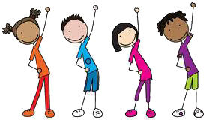
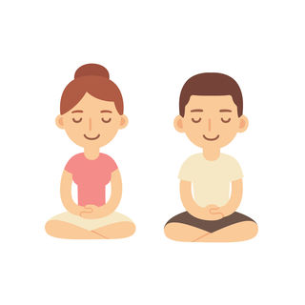
Practicing our Personal Wellness
Let’s get some exercise for our Physical Wellness!
https://www.youtube.com/watch?v=d_GNRDic17E
Now let’s exercise our minds…
https://www.youtube.com/watch?v=bRkILioT_NA

Slide 8
Your Health and Well-Being Tool
Create a Wellness Fortune Teller!
How to make a Fortune Teller (wikihow)

